Slide 1

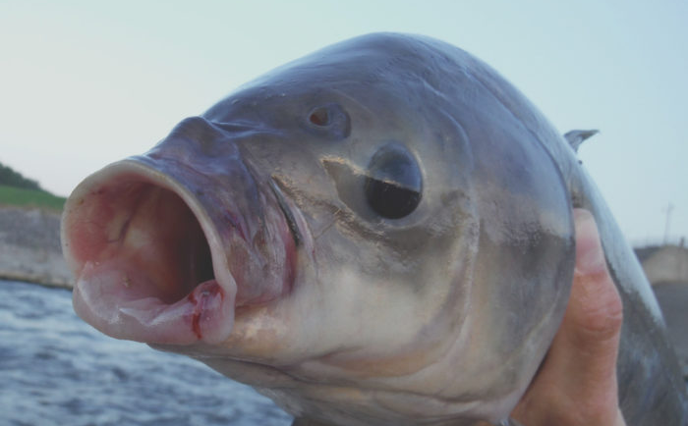
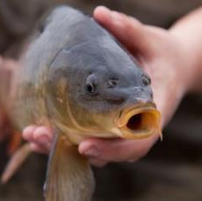
Modeling factors that affect carp and buffalo electrofishing catchability
Marty Simonson
ISU Department of Natural Resource Ecology and Management

Slide 2
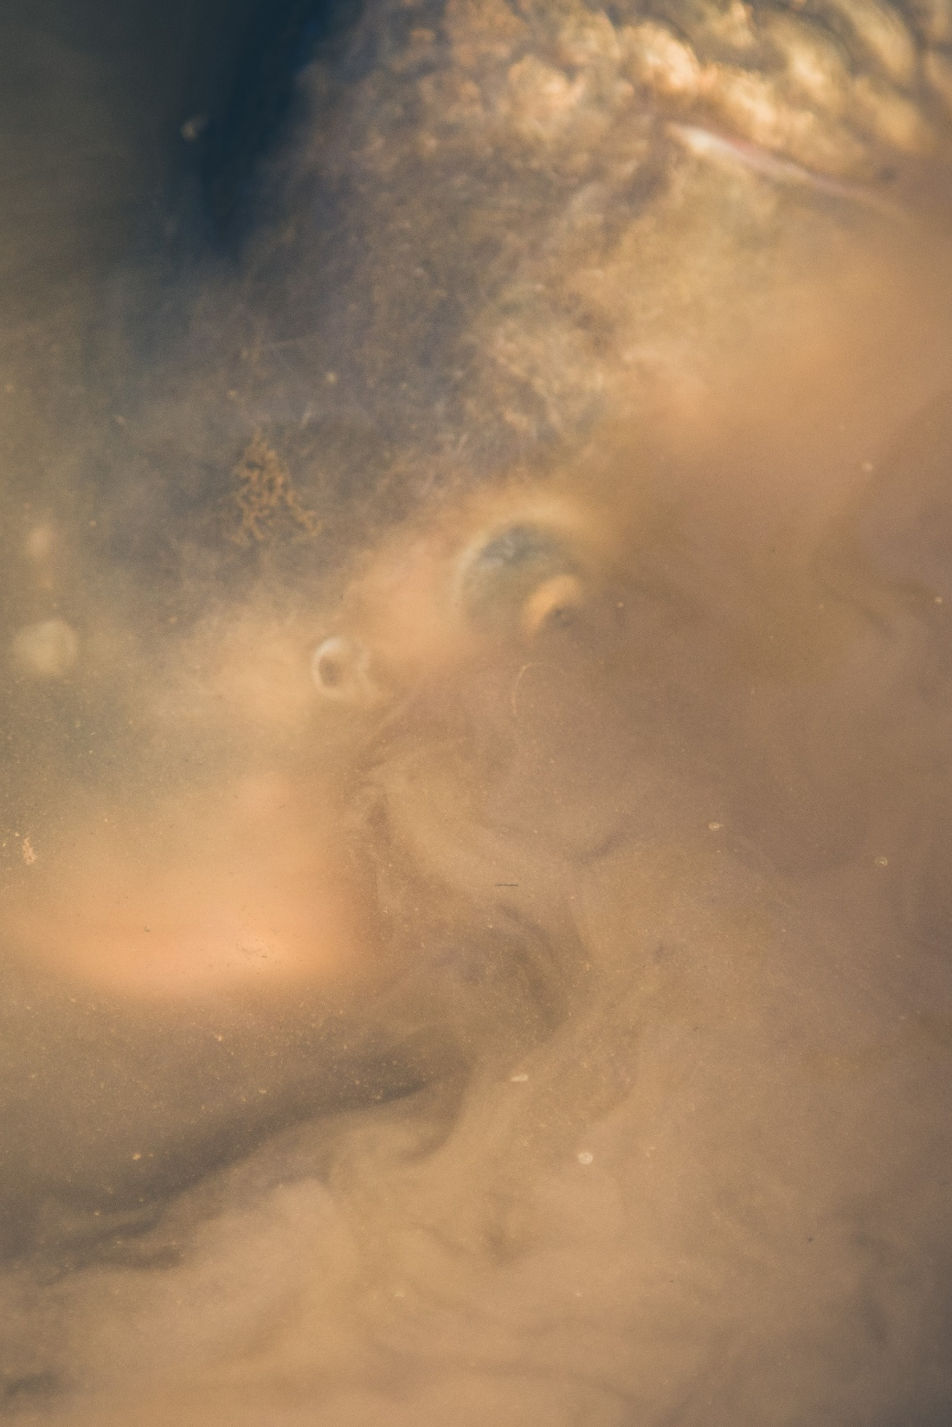
“Rough” Fish
Generally considered a nuisance
Increase turbidity through resuspension of sediments
Impacts nutrient levels, macrophyte growth, wildlife
Frustrates anglers and non-anglers

Slide 3
Study Sites
220 acres to 3,000 acres
Mean depth 5’ to 15’
Different shoreline complexities
Round vs. Elongated
Different biomass densities of carp and buffalo
Assumed constant within lake, within year
Repeated electrofishing runs generate >10 CPUE daily events per lake per year

Slide 4
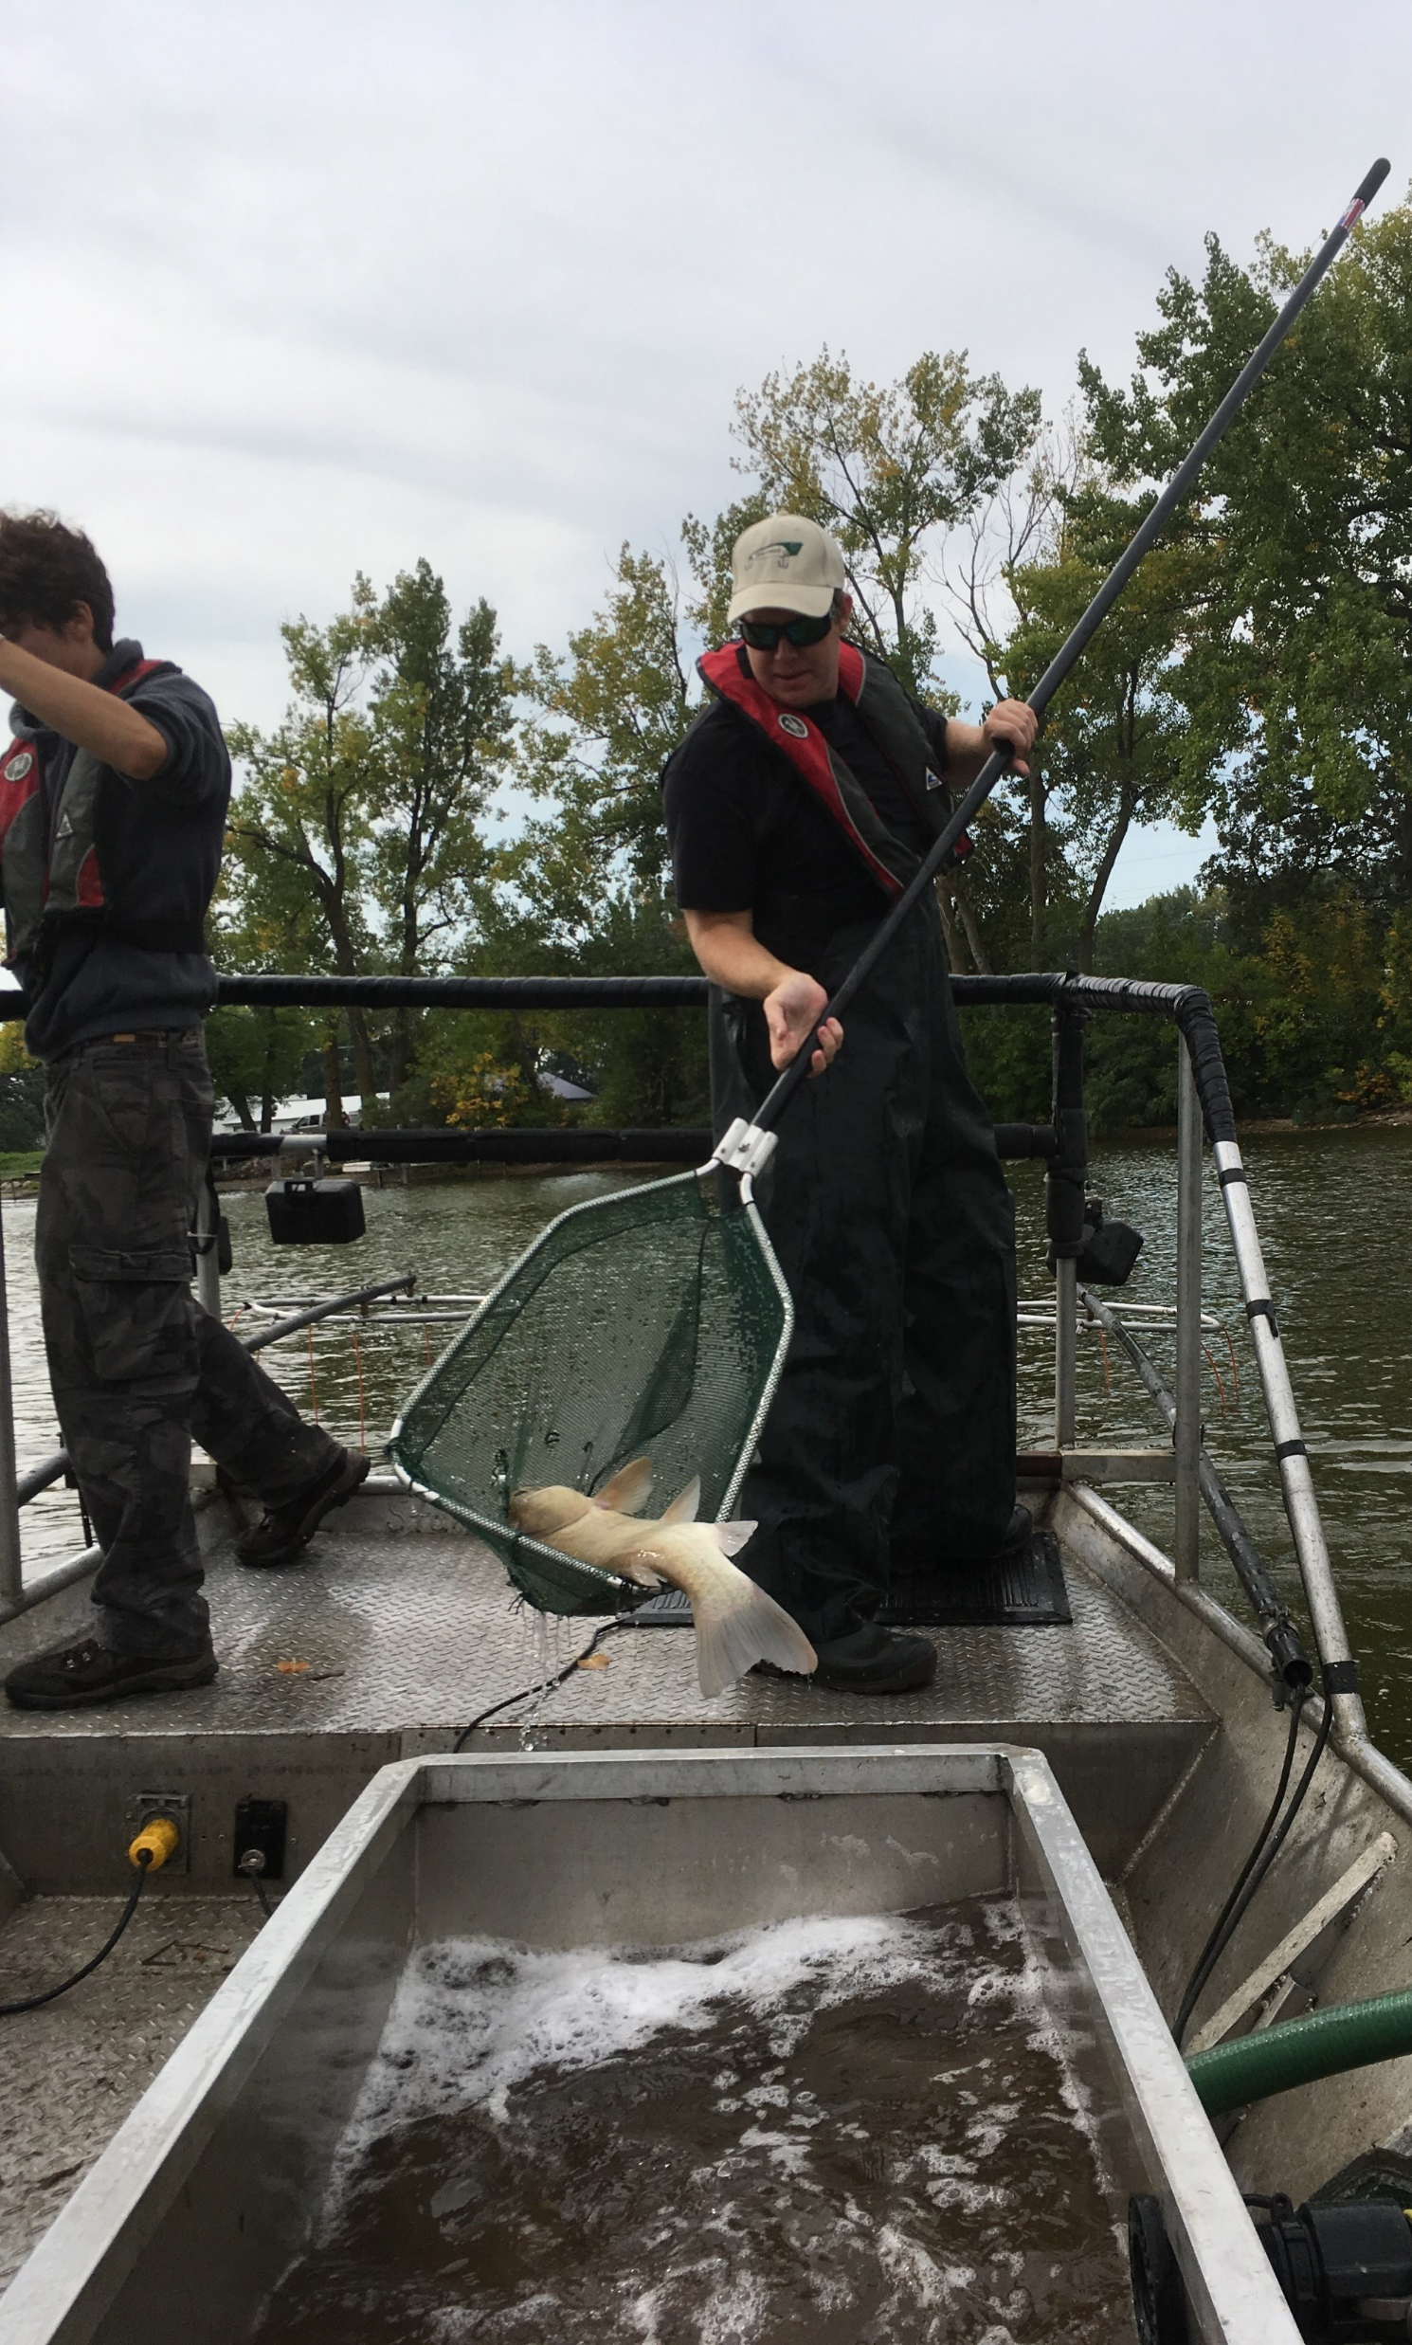
Sampling Fish Populations
Electrofishing:
-Commonly used for game and non-game species
-use of electricity to temporarily stun fish
Catch per unit effort (CPUE):
-IF CPUE is directly proportional to population size, relative abundance can be estimated

Slide 5
Catchability and Catch-per-Unit-Effort functions
Catchability may vary as a function of:
-water temp (metabolism)
-shoreline complexity
-lake size and depth (amount of littoral area)
Foundational Equation:
CPUE = q*(N/area)
CPUE/q = (N/area)
*q = catchability coefficient*
CPUE/(N/Area) = q

Slide 6
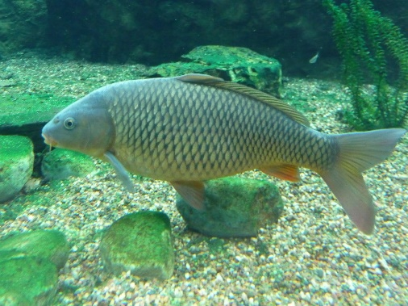
Objective
We want to model a distribution of q, the catchability coefficient.
Catchability is a latent, unknown variable
We hypothesize that catchability may vary as a function of 5 variables:
Water Temperature
Lake Size (hectares)
Lake Depth (meters; both maximum and mean)
Shoreline Development Index (1.0 = perfect circle, increases as lakes are elongated/sinuous)
Only temperature varies within a lake/year. The depth and shoreline factors vary among lakes but are constant within a lake and from year to year.
We have independent data sets:
CPUE data (# of fish per hour electroshocking)
Capture-Mark-Recapture data (abundance estimates, which we transform to biomass density (kg/hectare)

Slide 7
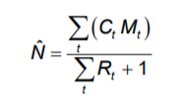
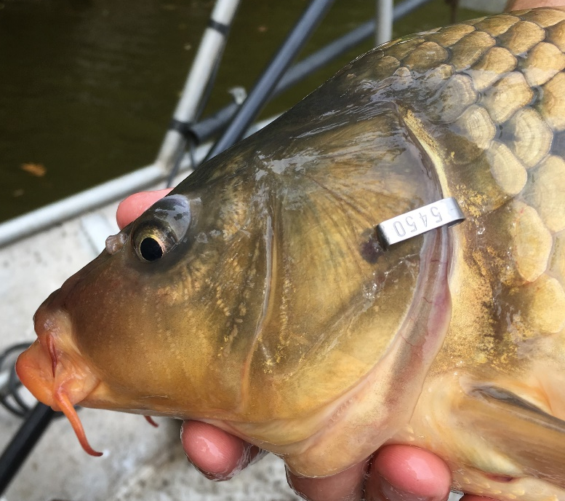
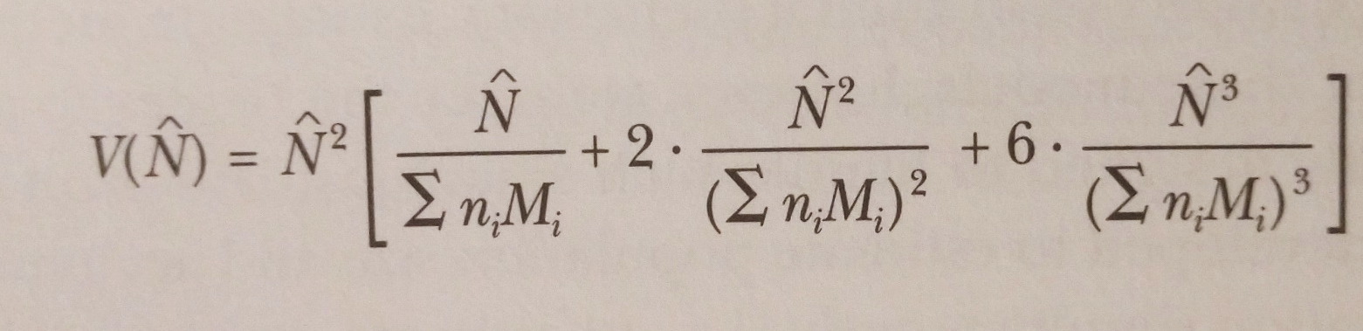
Estimating population size
Ct= Total # caught in sample t
Mt= # marked in pop. just before t sample taken
Rt= # marked in sample t
Mark-Recapture
-Electrofishing
-STANDARD RUNS
-Individually numbered tags
-Marking on all occasions
-Multiple recapture events
Schnabel population estimate
-Extension of the Lincoln-Peterson
-Associated observational error
-Independent from CPUE data
Biomass Density
-Length-Specific Weight applied to N-hat
-Includes observational error

Slide 8
Example:
One Species
One Lake
One Year
Expected value:
Observed Data:
Unknown Distribution:
Observation error
Schnabel pop est.
Observation error
Pop size (N-hat)
Length-specific weight:
Sum(mean weight for length bin i * proportion of length bin i *
N-hat)
Biomass Density (kg/ha)
Constant through sampling season
CPUE
CPUE
CPUE
1
2
i
LAKE-SPECIFIC VARIABLES
Unknown
Catchability
Mean Depth
i
Water Temp.
i
SAMPLE-SPECIFIC VARIABLE
Max Depth
SAMPLE-SPECIFIC VARIABLE
Lake Size
Shoreline Index

Slide 9
Priors
Log N
sd
B0
B1
B5
Latent Variables
Expected
Log CPUE
Catchability
Water Temp
tau
Shoreline Complexity
Log CPUE
Lake Area
Data
Log Schnabel estimate
Mean Depth
MAX depth
sd Log Schnabel estimate
tau N

